Slide 1
The Global Feed Industry : Working together for the Future
Daniel Bercovici, IFIF Chairman
The Summit
28-29 May 2019 | Moscow, Russia

Slide 2
Agenda
IFIF – one global voice for our industry
Global Feed Production
Global challenges we face
Working together at regional & global level

Slide 3
I. IFIF – one global voice for our industry

Slide 4
IFIF’s Vision One global voice for our industry
“IFIF’s vision is to provide a unified voice and leadership to represent and promote the global feed industry as an essential participant in the food chain that provides sustainable, safe, nutritious and affordable food for a growing world population.”

Slide 5
IFIF is a global organisation – One Voice
Established in December 1987 – 32 years
IFIF is made up of :
National and regional feed associations
Corporate members
Feed related organizations
IFIF represents over 80% of the global compound feed produced
Notes:
65% of all compound feed is produced by just 4 association member countries
Europe, Brazil, USA, and China

Slide 6
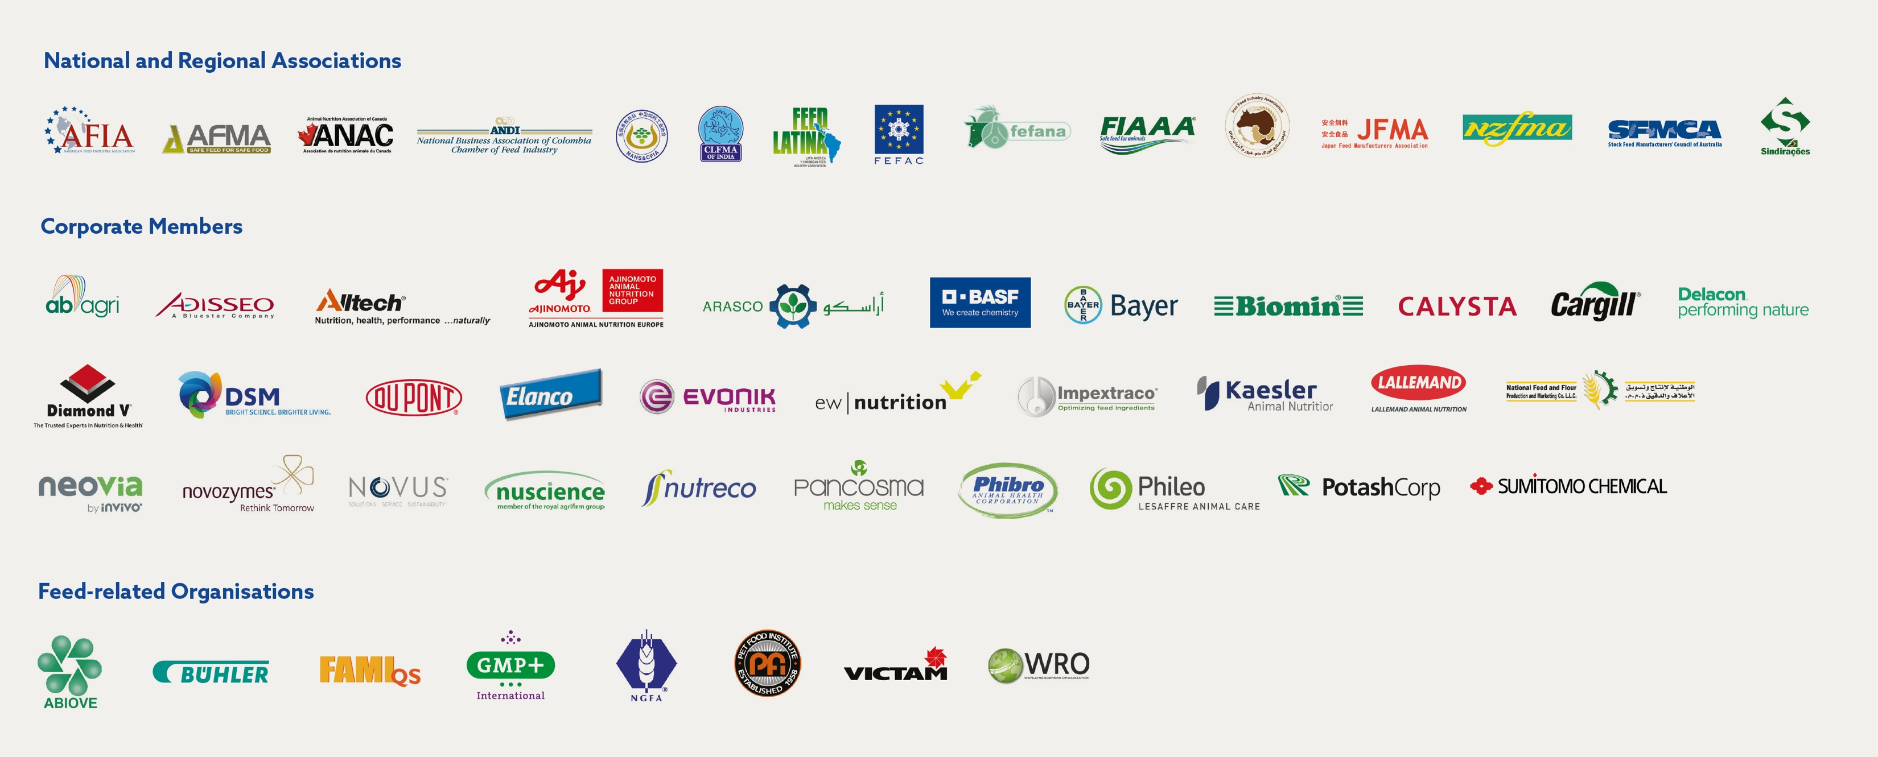
IFIF is a global organization & represents over 80% of compound feed production worldwide

Slide 7
IFIF’s Mission
Represent the global feed industry with international governmental organizations and agencies, including the FAO, WTO, WHO, OIE and CODEX Alimentarius, on crucial global feed and food issues.
Promote science-based solutions and information sharing for the feed industry by facilitating global forums, such as the Global Feed & Food Congress (GFFC) and the International Feed Regulators Meeting (IFRM).
Promote a balanced regulatory framework to support a fair global playing field, facilitate market access and support the competitiveness of the feed and livestock industries.
Expand the global network of national and regional feed associations and promote the adoption of international standards and global equivalency.
Continue to support and encourage the sustainable development of animal production.

Slide 8
IFIF’s 3 strategic Pillars of work & priorities
Sustainability
Regulatory & International Standards
Education and Sharing of
Best Practices

Slide 9
II. Global Feed Production

Slide 10
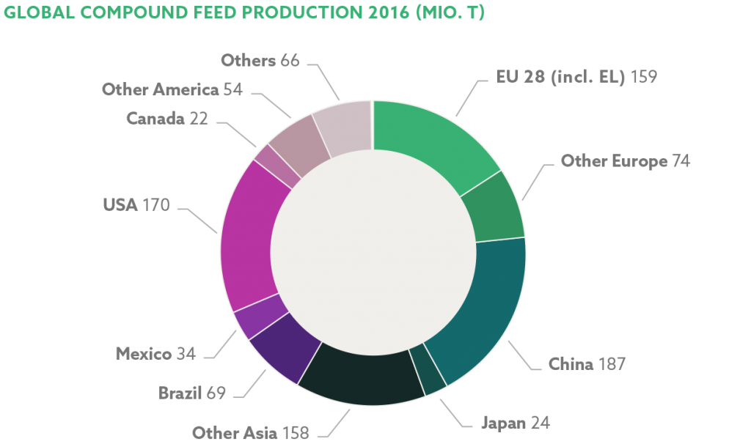
Global Animal Feed Production over 1 billion tonnes worth over $ 400 billion
Source: IFIF / FEFAC
Notes:
The growth seen in 2017 was strong at 2.57% over last year. The feed industry, valued at $ 430 billion, has seen a 13% growth over the past 5 years, equating to an average of 2.49% per annum. This substantial growth is supported by the higher reported consumption of meat, milk and eggs.

Slide 11
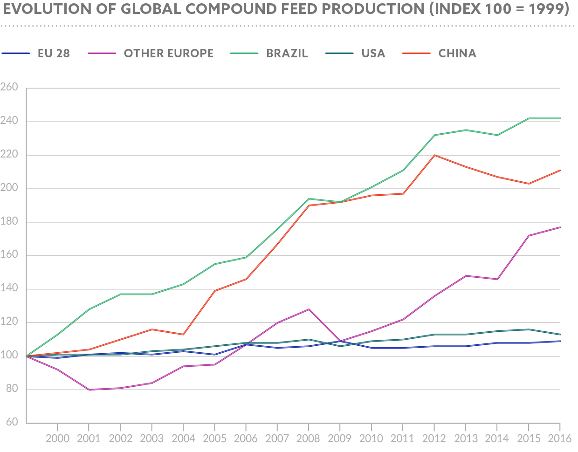
Source: 2017 IFIF estimates / National & Regional Associations

Slide 12
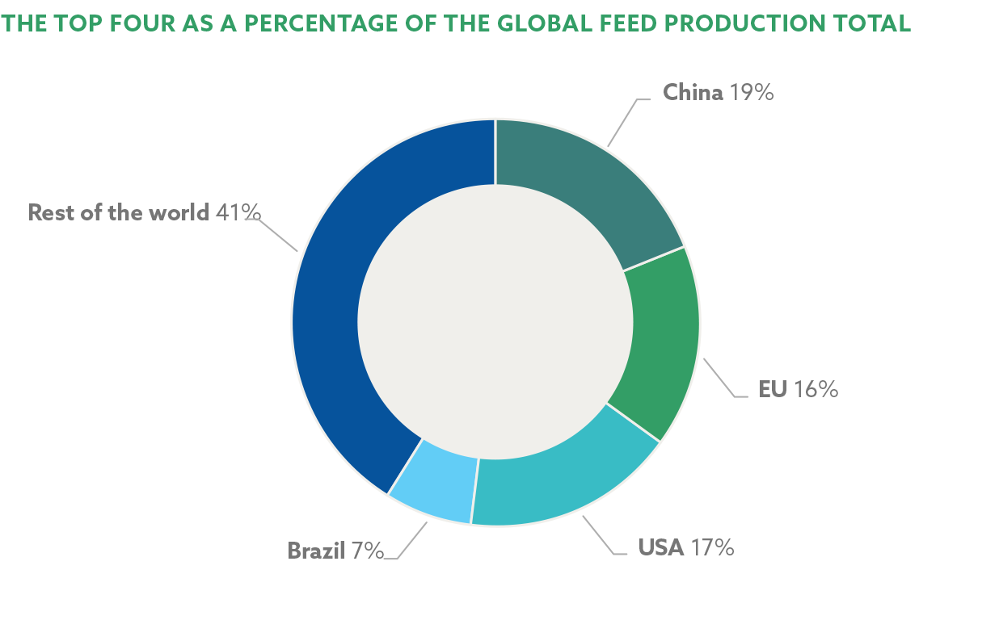
4 countries produce 60% of compound feed
Source: 2017 IFIF estimates / National & Regional Associations
Notes:
China and the US remain the top 2 countries, producing one-third of all animal feed, and that predominant growth came from the pig, broiler and dairy feed sectors as well as the European and Asia-Pacific regions.

Slide 13
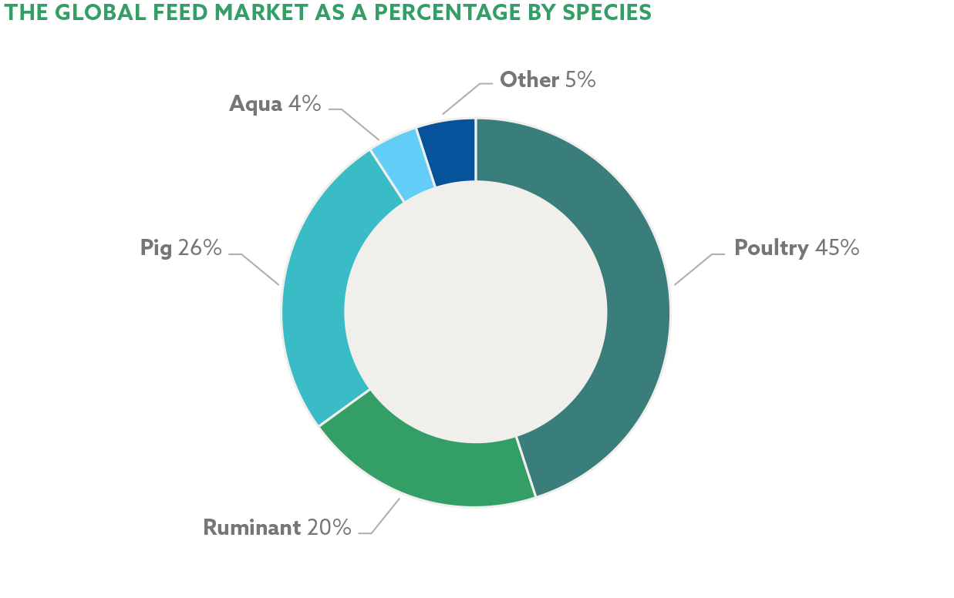
Almost half of compound feed goes to poultry
Source: 2017 IFIF estimates / National & Regional Associations
Notes:
Poultry feed represents 45% of world feed reflecting cost, health and religious preferences and the integrated nature of this business.

Slide 14
Russia’s feed production – a global player
In 2017, over 500 feed mills produced around 37 million metric tons of animal feed.
Russia is one of the top feed producers in the world, having passed India, Mexico and Spain in production, despite the respective feed production increases of each of these countries in 2017.
Russia’s feed production is increasingly becoming self-sufficient and less reliant on imported meat, milk and eggs.

Slide 15
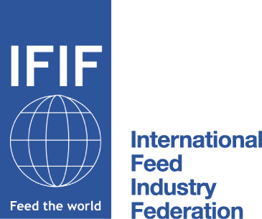
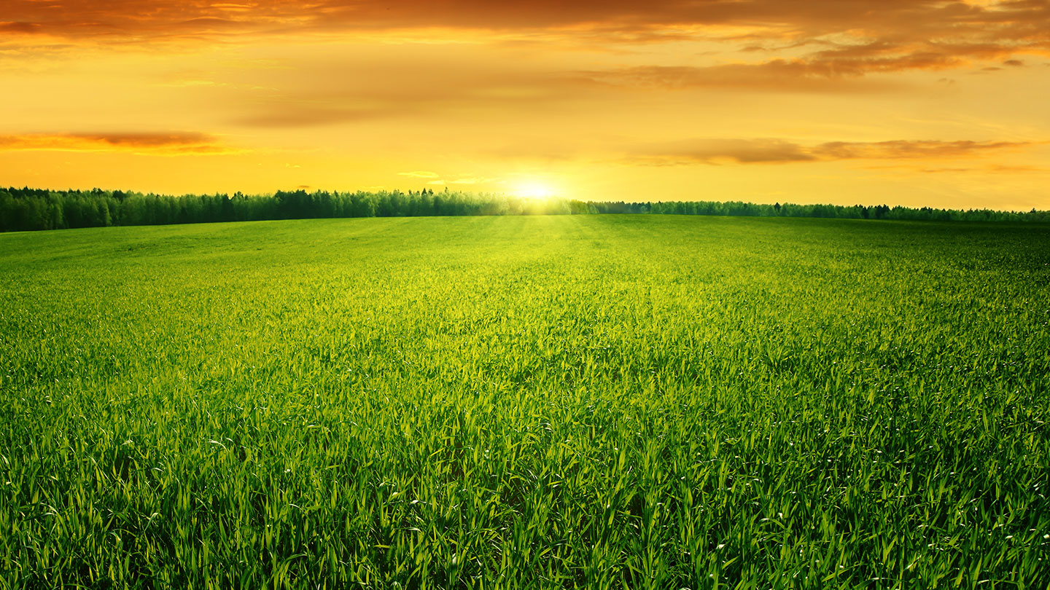
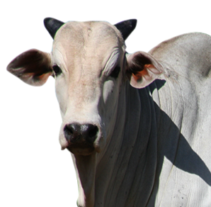
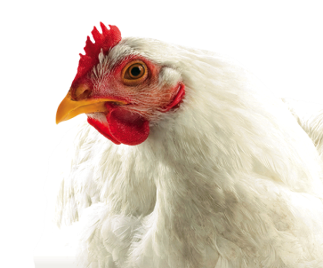
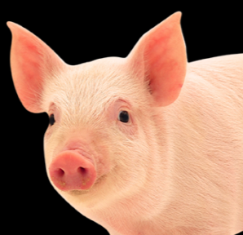
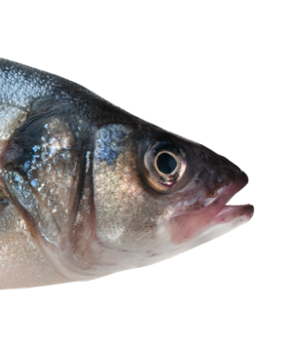
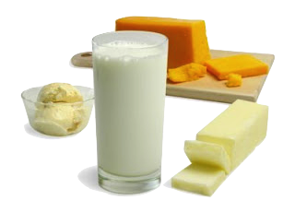
World Protein Production 2017-2018 Million metric tons
Bovine
Poultry
Pigs
Aqua
Milk
Total
2017
70.9
119.9
118.8
83.6
810.9
1204.1
2018*
72.2
121.6
120.6
87.0
826.9
1228.3
% ch
1.5%
1.4%
1.6%
4.0%
2,0%
2.0%
Source: FAO Global Food Outlook November 2018 / * 2018 FAO forecast

Slide 16
III. Global challenges we face

Slide 17
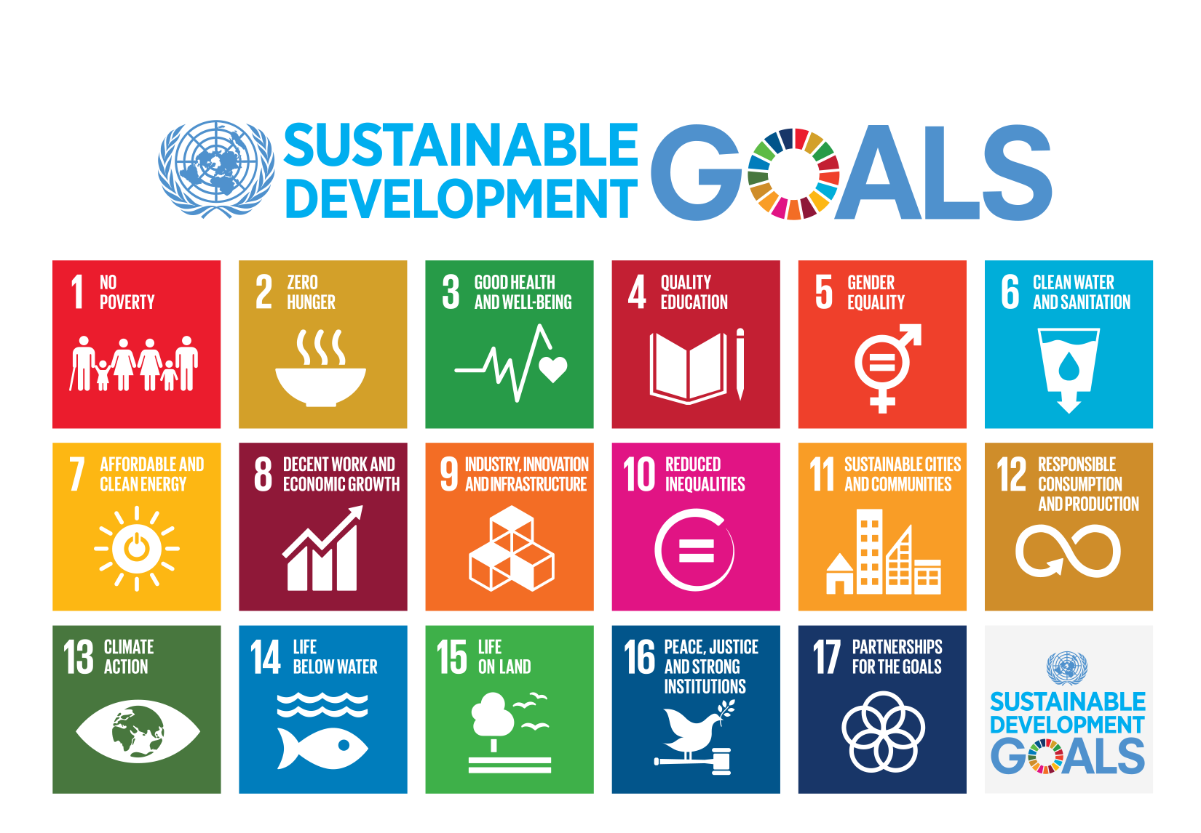
United Nations

Slide 18
World Population Growth & Meat Consumption
The Key Drivers For Meat Demand
Global Population Increase
+
Global Rise in Per Capita Income
(GDP)
Notes:
Slide 22:
The key drivers for livestock products are: population increase and rising GDP.

Slide 19
World Population Growth & Meat Consumption
Billion people
Million Tons
Source: UN
Notes:
World population growth is one of two underlying factors that drive the feed business. In concert with a growing world population, incomes are rising and that is driving up the demand meat which, as you can see by the green line, has been rising rather steadily for the past 40 years. More meat production means more demand for grain.
Population growth is the most predictable. From 1986 to 1995, world population grew annually by 1.6%. In the past 10 years, the rate has slowed to 1.3% annually. Nevertheless, the world added 75 million new people last year and today there are 6.5 billion consumers.

Slide 20
The FAO forecast
In 2050 we will be ca. 10 billion people in the world…
…and the need for food will be 60% higher than today
How do we feed this population?

Slide 21
FAO Outlook 2010 to 2050: times 1.6! Animal protein / million metric tons
Bovine
Poultry
Pigs
Aqua
Milk
Total
2010
66.7
98.9
109.3
59.9
722.9
1,057.7
2050
107.5
201.9
150.3
113.7
1,119.7
1,693.1
In 2050:
meats 433.1 million tonnes - + 1,3% APR
aqua 113.7 million tonnes - + 1.6 % APR
milk 1119.7 million tonnes - + 1.1 % APR
1.6X
Source: FAO Global Food Outlook November 2012/ FAO World agriculture towards 2030/2050 - 2012 Rev / OECD FAO Ag Outlook 2013

Slide 22
FAO Stats
Meat & Fish production will increase almost 2 fold ...
…will this represent the production of feed, grains and cereals at the same rate?

Slide 23
The sustainability challenge:
Produce more
Using Less
Even better
At an affordable cost to consumer

Slide 24
6Fs Many competing for the same resources
Feed
Food
Fiber
Fuel
Forests (planted)
Farma

Slide 25
Keeping it affordable
Brazil
Europe / US
Africa
% share of family income spent on food
20%
5%
70%

Slide 26
What does this mean for feed industry?
Efficiency, Science & Innovation
International Standards, e.g. CODEX
Good Manufacturing Practices
Produce more, using less, even better

Slide 27
But sustainable is also: Safe Feed & Safe Food
Sustainable also means: feed safety and quality, and adhering to international standards
Animal feeding plays a leading role in the global food industry and feed is the largest and most important component to ensure the sustainable production of safe and affordable animal proteins.
Notes:
How to meet increased demands by consumers given increase in world population to 9 billion by 2050 sustainably and affordably?

Slide 28
Sustainability for the feed industry
Safe feed supply
Competitive feed industry
Resource-efficient feed industry
Responsible feed chain

Slide 29
IV. Working together at regional & global level

Slide 30
IFIF works with partners along the chain Supporting the global feed industry
International Feed & Food Safety
Global groups
WTO
(IFIF STDF grants)
Codex Alimentarius
(IFIF Codex recognized NGO)
FAO
(IFIF FAO MOU)
OIE
(IFIF OIE Collaboration agreement)
WHO
(Feed expert group with FAO)
IFIF
Private Sector
Regional & National Associations
Corporate Members
Feed related Companies
Agri-Chain Partners
Notes:
IFIF collaborates with the FAO, WTO, WHO, OIE and CODEX, to help set effective international regulatory standards for the whole feed chain.

Slide 31
Agri-Chain partners include:
International Dairy Federation (IDF)
International Egg Commission (IEC)
HealthforAnimals
International Fertilizer Association (IFA)
International Marine Ingredients Organization (IPPE)
International Meat Secretariat (IMS)
International Poultry Council (IPC)
World Farmers Organisation (WFO)

Slide 32
IFIF’s 3 strategic Pillars of work & priorities
Sustainability
Regulatory & International Standards
Education and Sharing of
Best Practices

Slide 33
IFIF’s 3 strategic Pillars of work & priorities

Slide 34
Pillar 1: Sustainability
IFIF/ FEFANA Specialty Feed Ingredients Sustainability Project (SFIS) – establish positive role of SFI’s on the environmental impact of livestock production (poultry / pigs)
Global Feed LCA Guidelines Institute (GFLI) - develop global Feed LCA Guidelines database to measure environmental performance of the livestock sector
FAO-led Partnership on Livestock Environmental Assessment and Performance (LEAP) - developed Feed LCA Guidelines & improve environmental performance of the livestock sector
Global Agenda for Sustainable Livestock – addressing UN Sustainable Development goals with stakeholders at global level
Nutritional Innovation to Promote Animal Health - Positioning of animal nutrition (AN) as an important contributor to promote animal health and welfare

Slide 35
Animal nutrition important contributor to promote animal health & welfare
Nutritional Innovation - adequate nutrition support animals’ defence against stressors by:
Maintaining animals in good health with high resilience capabilities to stressors, such as pathogens
Limits the need for antimicrobial treatments to targeted applications under veterinary prescription
Through:
Feed preservation and reduction of the presence of mycotoxins in feed:
Limit the potential for colonization of the feed by undesirable microorganisms
An additional layer of safety by reducing the negative effect of undesirable substance such as mycotoxins
Improvement of gut functioning and immunity:
Improve the digestibility of feed ingredients, hence limiting the presence of anti-nutritional factors and the risk of gut inflammation
Maintain a proper balance in the gut microbiome, limiting the development of potential pathogens or undesirable microorganisms in the gut
Micronutrients and other Specialty Feed Ingredients also support the proper function of the immune response to stressors

Slide 36
Pillar 2: Regulatory & International Standards
IFIF collaborates with the FAO, WTO, WHO, OIE and CODEX, to help set effective international regulatory standards for the whole feed chain, and aims to harmonise these globally, ensuring its safety and access to markets in order to provide safe feed & food and facilitate fair trade.
International Feed Regulators Meeting (IFRM)
International Cooperation for Convergence of Technical Requirements for the Assessment of Feed Ingredients (ICCF) covering Canada, European Union, and United States
Codex Alimentarius Feed related work
OIE formal collaboration
Notes:
IFIF aims to harmonise the regulatory framework for the production and commercialization of animal feed globally, ensuring its safety and access to markets, based on the standards and recommendations of Codex and the OIE.
Consumer confidence and trust is foundation - need for effective international feed standards and food safety along the entire chain.
Consumers and companies benefit from harmonised international standards.
Shaping of feed standards

Slide 37
Pillar 3: Education & Best practices
IFIF & FAO “Feed Manual of Good Practices”
Capacity Development: IFIF Global Animal Nutrition Programme
Annual IFIF FAO Meeting
6th Global Feed & Food Congress held March 2019 in Bangkok, Thailand
Notes:
Facilitating Dialogue at regional and international level with industry and regulators

Slide 38
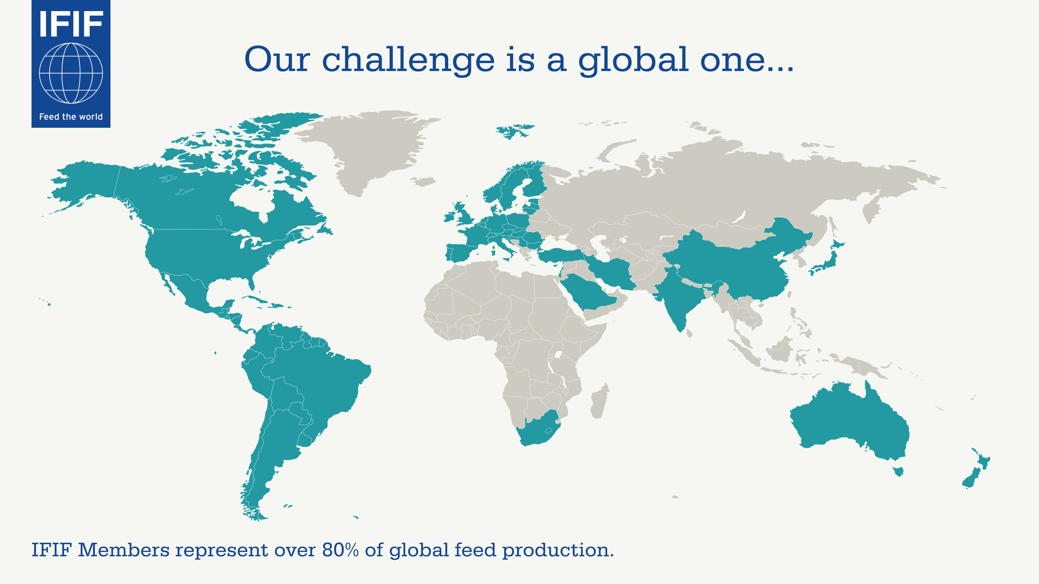

Slide 39
How can we work together? Russia as a player in the global market
Russian Feed Production ca. 30 mt
Bring in feedstuffs, such as corn and soybean meal
Support better feed conversion ratio & improve efficiency
Biosecurity measures – learn from each other
Promote science-based decision making
Continue to defend new technologies & innovation
Work towards Fair Trade
Work together to produce more, using less, even better

Slide 40
Looking Ahead
The agri chain, including industry, regulators and other stakeholders must continue to work together to contribute to the sustainable supply of safe, healthy feed and therefore food of animal origin to meet the demands of the global growing population in the years to come.

Slide 41
Thank you!
For more information please contact:
daniel.bercovici@ifif.org
alexandra.athayde@ifif.org
www.ifif.org

